Slide 1
跟着Kevin学英语(4)
认识字母表
G P C S N

Slide 2
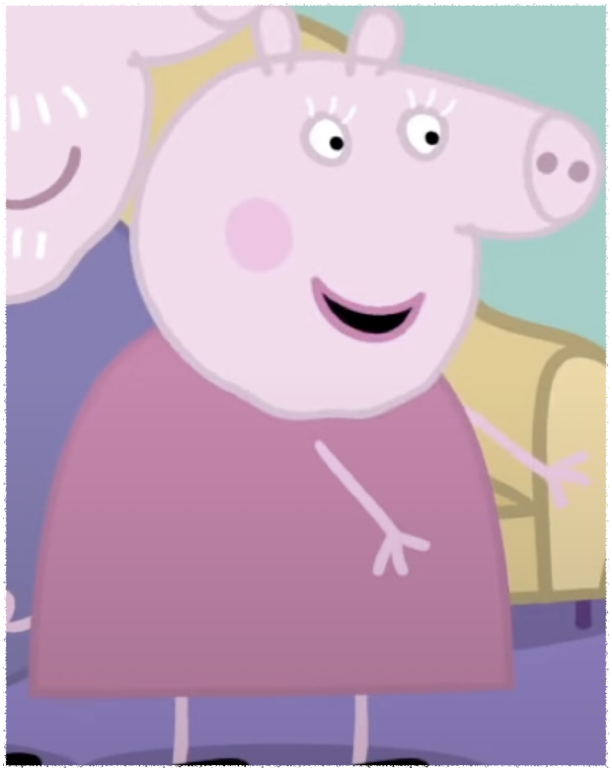
G g
Granny
Grandpa
Notes:
Say something to Polly

Slide 3
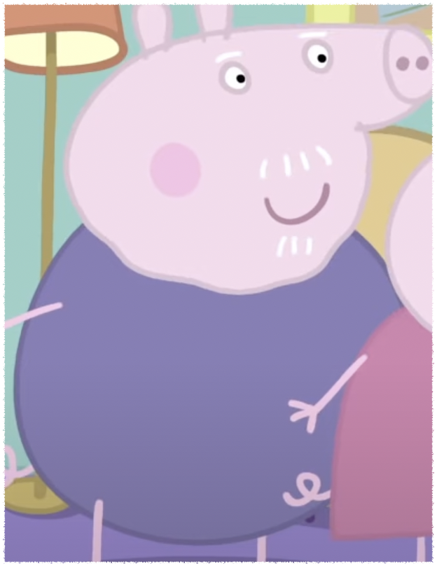
G g
Granny
Grandpa
Notes:
This is grandpa pig

Slide 4
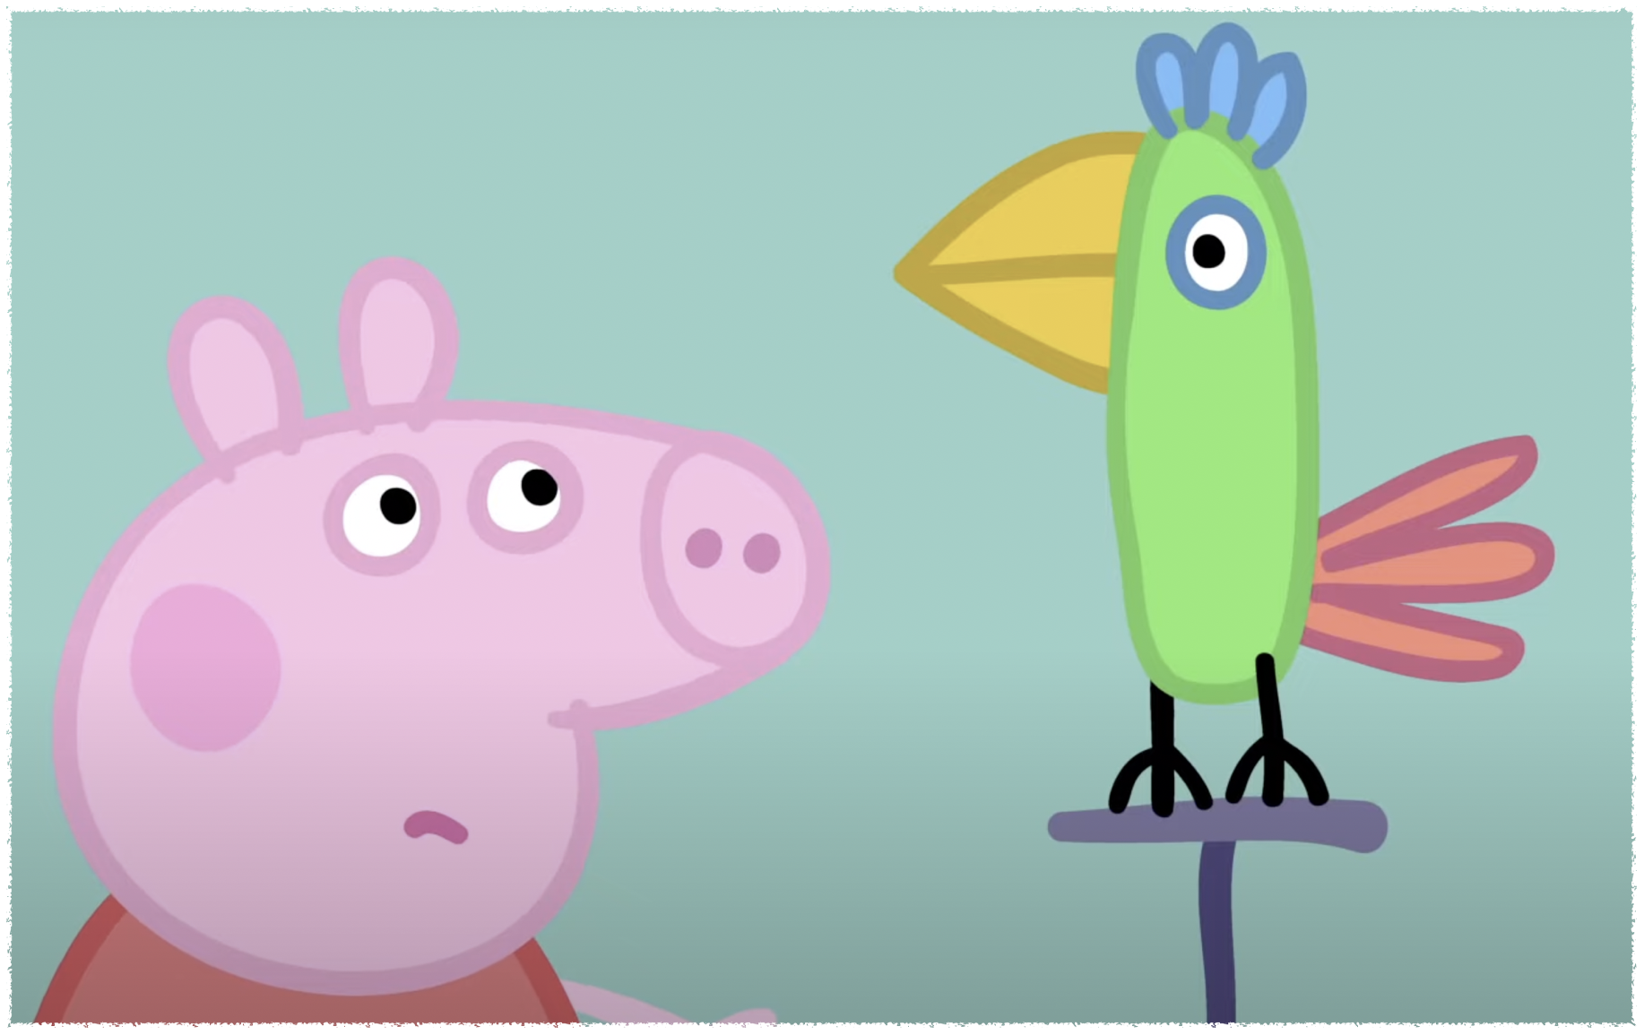
P p
Parrot
Pet
Pretend
Notes:
Say something to Polly

Slide 5
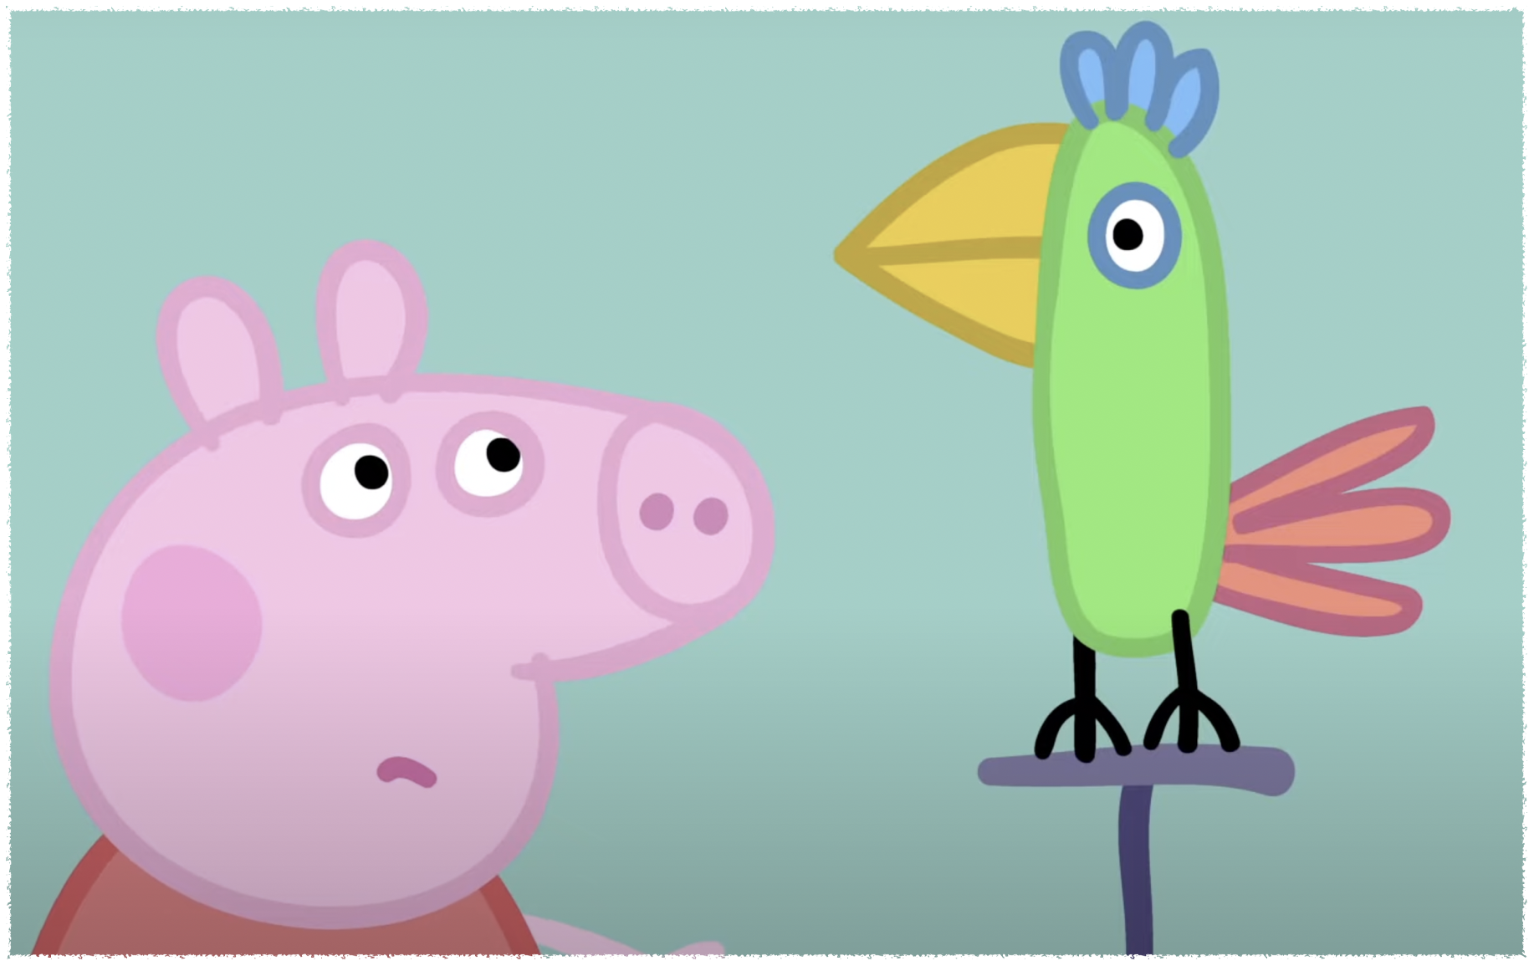
P p
Parrot
Pet
Pretend
Notes:
We have a new pet

Slide 6
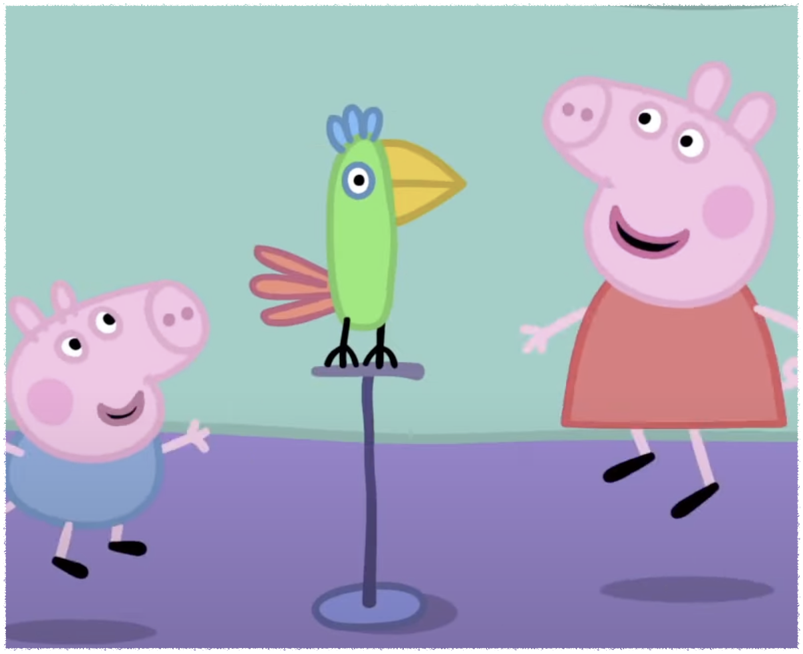
P p
Parrot
Pet
Pretend
Notes:
Peppa and George are prepending to be parrots

Slide 7
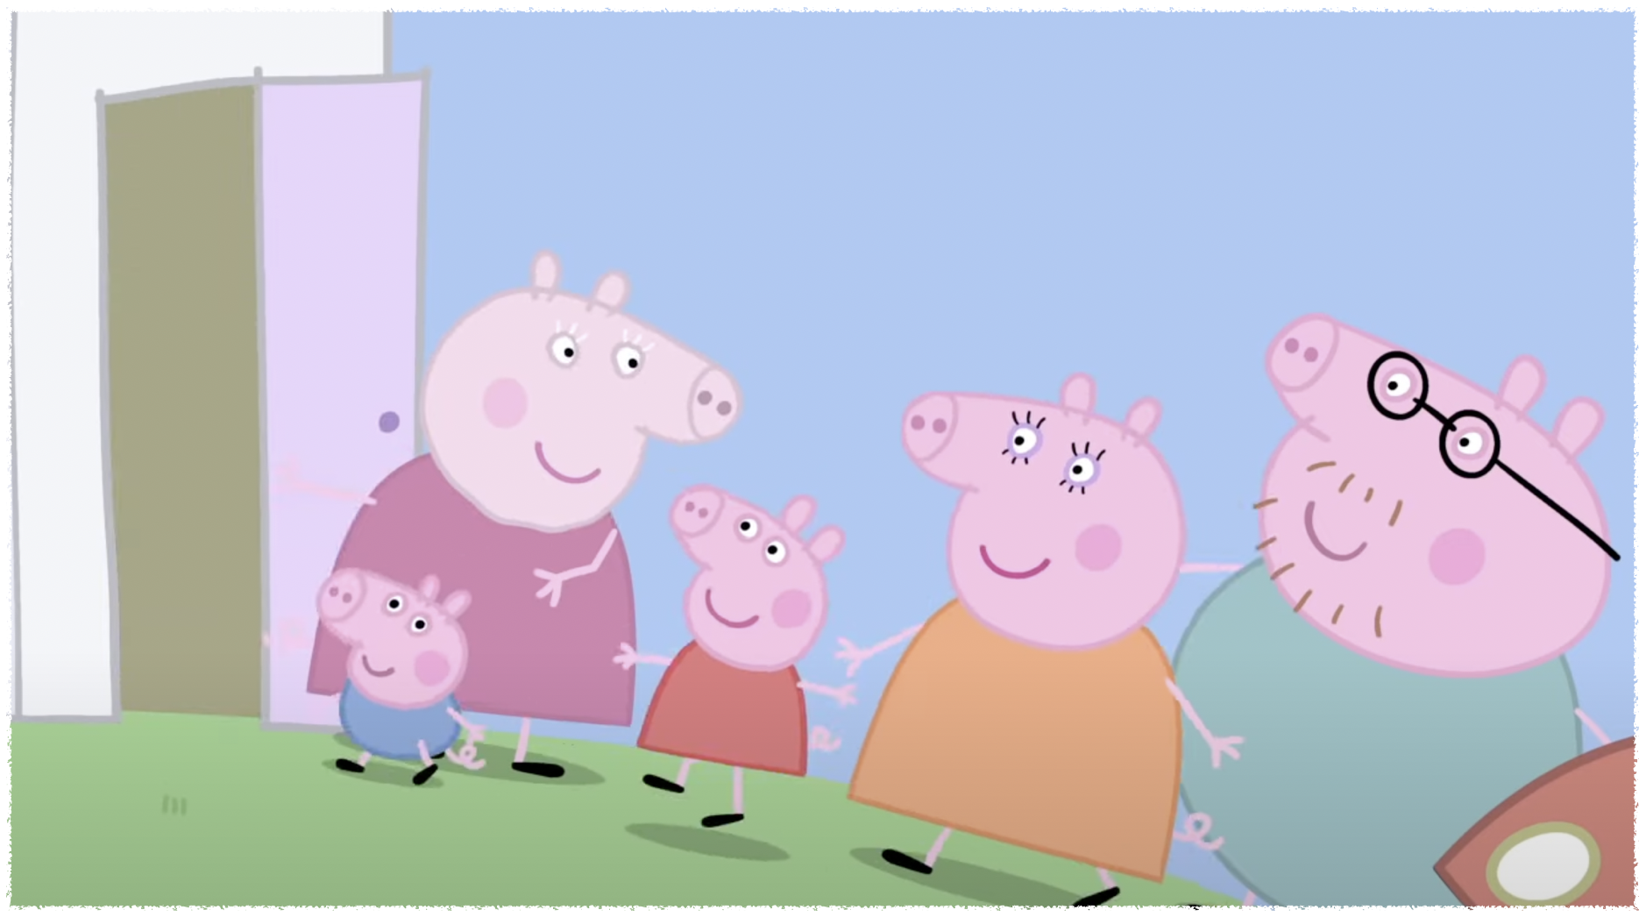
C c
Come
Clever
Cake
Notes:
Come here

Slide 8
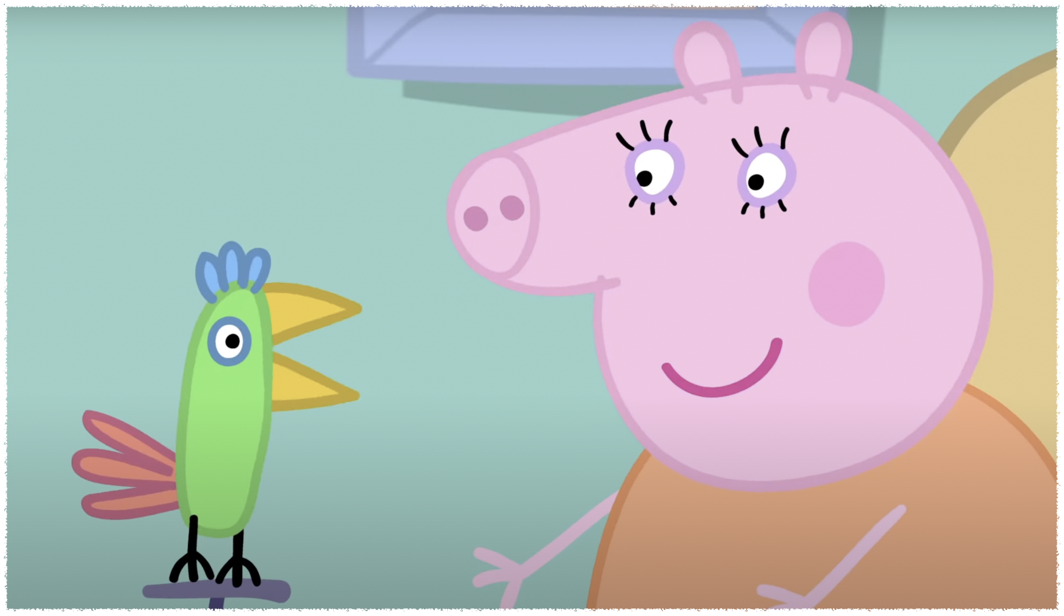
C c
Come
Clever
Cake
Notes:
I am a clever parrot

Slide 9
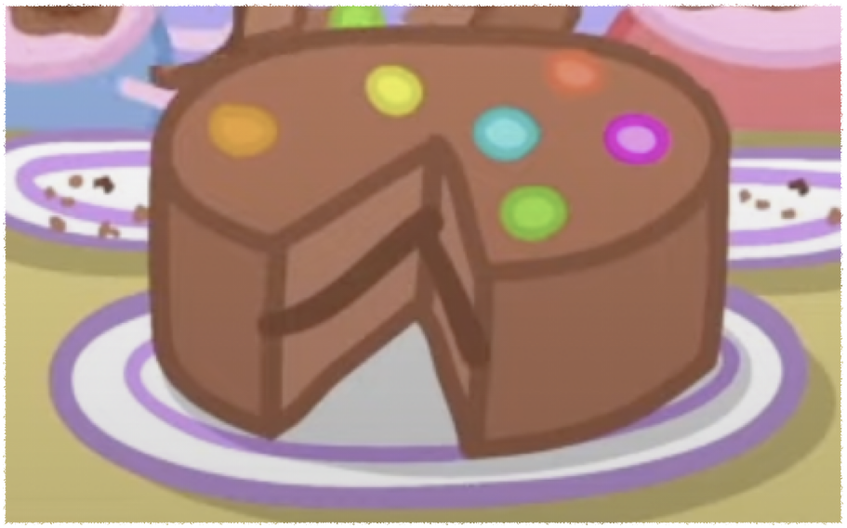
C c
Come
Clever
Cake
Notes:
That’s chocolate cake

Slide 10
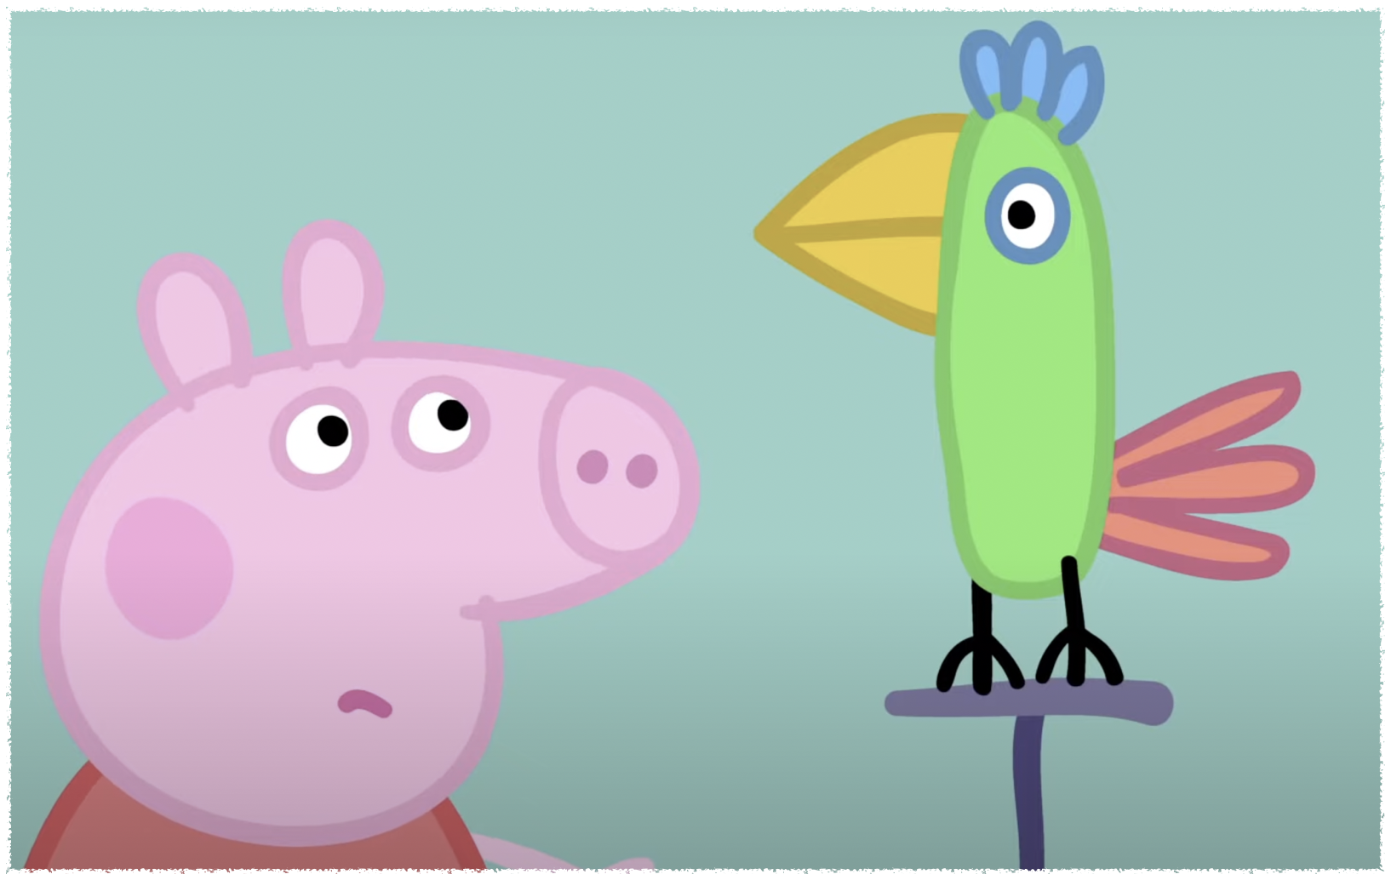
S s
Say
Sweet
Notes:
Say something to Polly

Slide 11
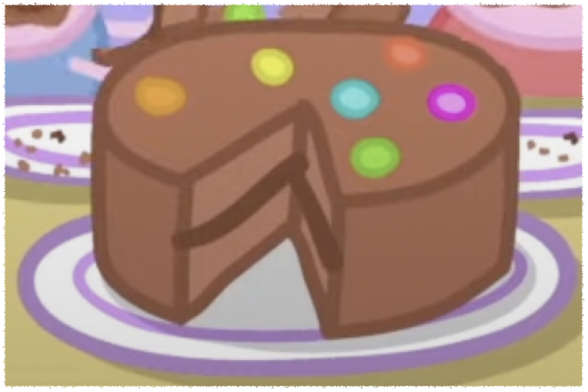
S s
Say
Sweet
Notes:
This cake is very sweet

Slide 12
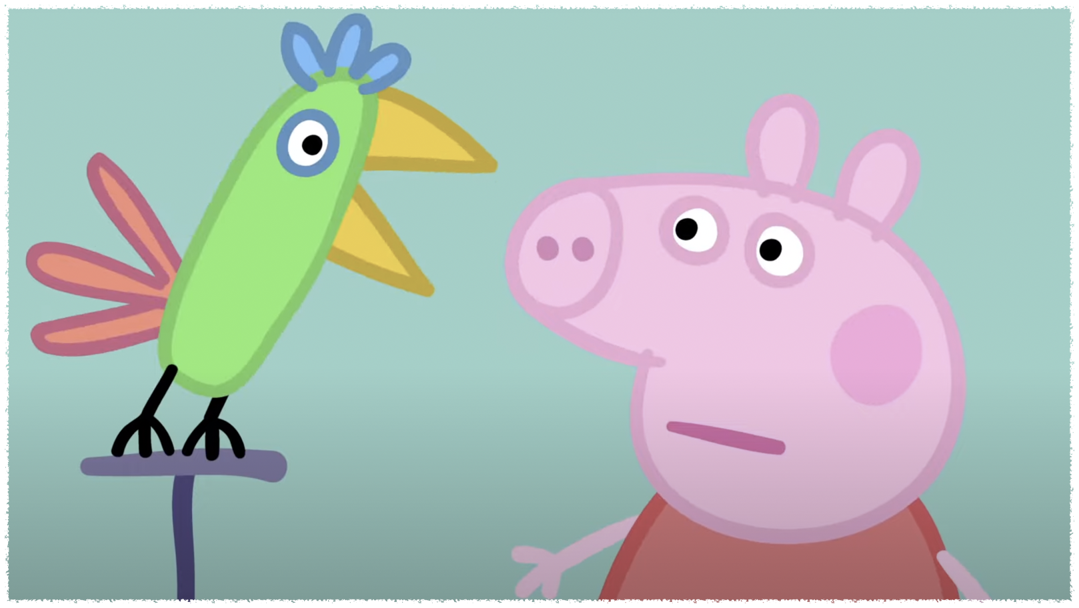
N n
Noisy
Notes:
I am a noisy parrot

Slide 13
Can you guess what it is?
I will show you
Oh my god They are in a hurry

